Slide 1
What is stress?

Slide 2
What is stress? What does it feel like? What does it look like? What does it sound like? What does it smell like?
Image: pixabay.com

Slide 3
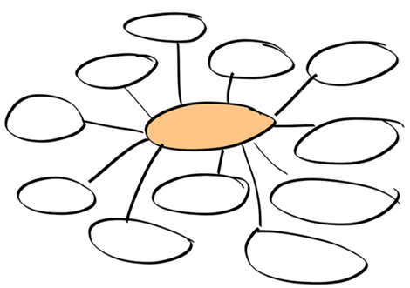
What sort of issues could cause stress? Create a class mind map.
Image: pixabay.com

Slide 4
Inside the empty brain, draw a picture of the things that make you feel stressed or worried.
Image: pixabay.com

Slide 5
Watch the video ‘Dealing with stress and anxiety’ available here:
https://www.childline.org.uk/info-advice/your-feelings/anxiety-stress-
panic/managing-your-anxiety/ [accessed 29.05.2020].
Complete the table:
Physical reaction
Thoughts
Stress
Actions/behaviour

Slide 6
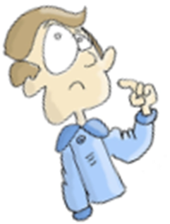
Is stress always a bad thing?
What are the positives to stress?
Is there an opportunity for stress to develop our virtues?

