Slide 1
Helping others with stress

Slide 2
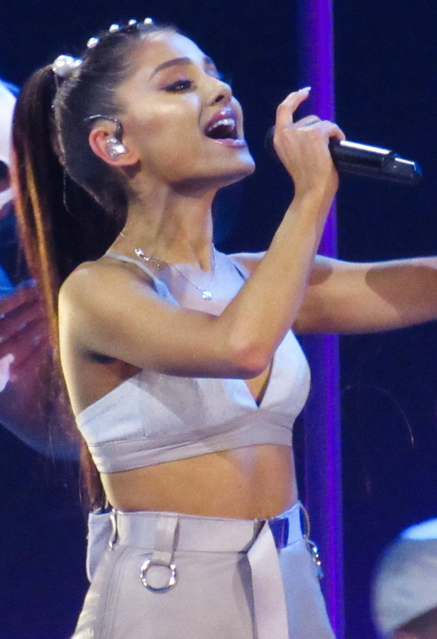
Who is this? What do you know about her?
She has spoken publicly about her battle with stress and anxiety. You can watch the video here: https://www.bbc.co.uk/newsround/46063045
What has helped her?
What virtues has she shown by sharing her story?
Image: commons.wikimedia.org

Slide 3
When we are feeling stressed and anxious, we can often choose either to face the fear or avoid the fear.
What are the short-term and long-term consequences of both of these decisions?

Slide 4
What is the problem?
How would you feel?
What virtues are involved in this scenario?
What do you think a ‘wise’ thing to do is? Why?
You have lots of school work to do and are very worried about your upcoming test. You had planned to use this evening to revise. Your friend invites you round to listen to some new music that you’ve both been excited about for ages. They tell you that you need to have a break and then can go back to your revision. If you don’t go, she will listen to them without you. What should you do?

Slide 5
Find someone who you think might be stressed or having a difficult time.
Do something kind for them.
It might be making them a drink, writing them a note or card or just taking the time to listen to them talk about how they are feeling.
Image: commons.wikimedia.org

