Slide 1
What makes a good friend?

Slide 2
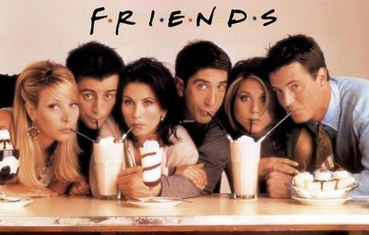
What makes a good friend?
Lyrics
So no one told you life was gonna be this way Your job's a joke, you're broke Your love life's D.O.A It's like you're always stuck in second gear When it hasn't been your day, your week, your month Or even your year, but
I'll be there for you (When the rain starts to pour) I'll be there for you (Like I've been there before) I'll be there for you ('Cause you're there for me too)
You, yeah
What does a good friend need to do according to this song? How might a friend show they do this?

Slide 3
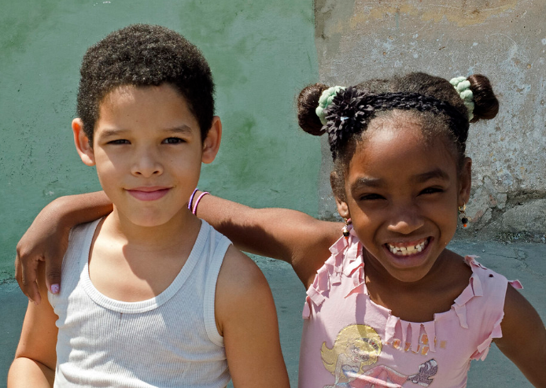
Think about the friends you have now, and friends you’ve had in the past.
What are the characteristics of a good or bad friend?
What virtues help you become a good friend to other people?
Trustworthy | Respectful | Affectionate
Generous | Caring | Humorous
Forgiving | Empathising | Patient
Distant | Selfish | Cruel
Two-faced | Ungrateful | Mean
Argumentative | Arrogant | Dishonest
Cooperative | Loyal | Encouraging
Sort the friendship value cards and rank them in pairs. Add any other friendship qualities you can think of.

Slide 4
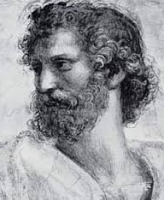
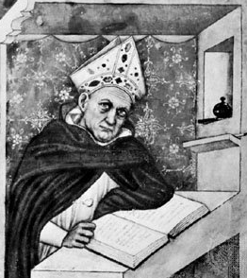
“There is nothing on this earth more to be prized than friendship.”
- Thomas Aquinas
"A friend holds a mirror up to us."
– Aristotle
What does Aristotle mean by this?
Why does Aquinas prize friendship so highly?

Slide 5
With a partner discuss the following questions:
• How do you choose your friends?
• What governs your choice of friends?
• Do your friends have anything in common?
• Do you make friends easily? Why/why not?
• What behaviour would stop you being friends?
Feedback to the group and discuss.

Slide 6
