Slide 1
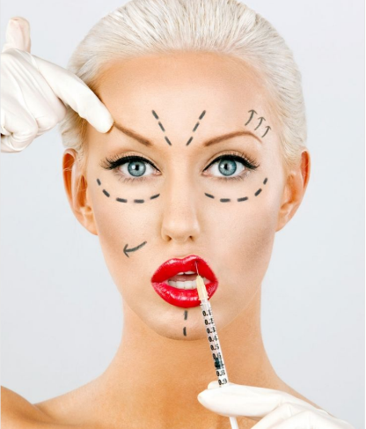
Body Image

Slide 2
Talking about selfies
Do you feel pressured into gaining ‘likes’ or portraying a certain image of yourself online?
How does that pressure affect you?
Explain that online pressure like this can be a test of our character. How might that be the case?
In what ways have you had to demonstrate your character in these instances?
Watch the‘Body Image and You’ film.
How can social media and the internet cause stress and impact on someone’s body image?

Slide 3
Quick fire questions!
What do we mean by ‘body image’?
How is that different to what a person’s actual body looks like?
What makes people think they need to look a certain way?
How does the media influence this? How does gaining likes and followers on social media make people feel?
Why is this important to some people?

Slide 4
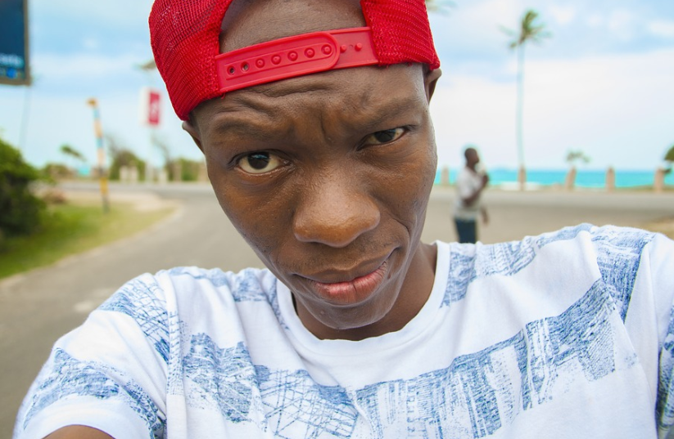
Behind the selfie
Choose a scenario and in groups discuss the following questions:
What might be going through each character’s mind?
What feelings and emotions could they be experiencing?
How might their body image and body confidence be affected by their experiences online?
Being healthy is more important than what makeup or hair styles are trending on social media. Why is that?
Is someone’s online profile an accurate depiction of who they are?
What lengths do some people go to create the perfect the selfie? Why?
1. John is trying to take the perfect selfie to post online. He feels really pressured to only post a picture in which he looks good.
2. Luke follows John. He thinks John’s pictures always look much better than his, and John’s large number of followers makes him feel down about himself.
3. Evie is John’s friend and is about to rate John’s selfie 3/10 as a joke. Other people start to say worse things about the photo, so John deletes his selfie.

Slide 5
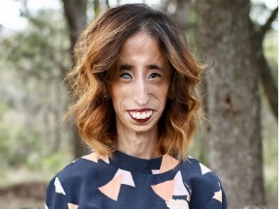
Thinking about Lizzie’s story:
If she were a student at this school, how could the school community support her?
How might you respond to Lizzie if she told you her story? What virtues would you need to use to ensure Lizzie felt supported and known?
Case Study
Read the story of Lizzie Velasquez once cyberbullied and labelled “the world’s ugliest woman.”
What difficulties did she face in life?
How was she treated in school? What are some of Lizzie’s positive traits or virtues that contribute to her positive self-concept?
What about her do you most admire?
How might her positive virtues and traits inspire and help others?
How does Lizzie demonstrate that ‘beauty is on the inside’?
Who in her life supported her, and how did this help build her self-esteem?

Slide 6
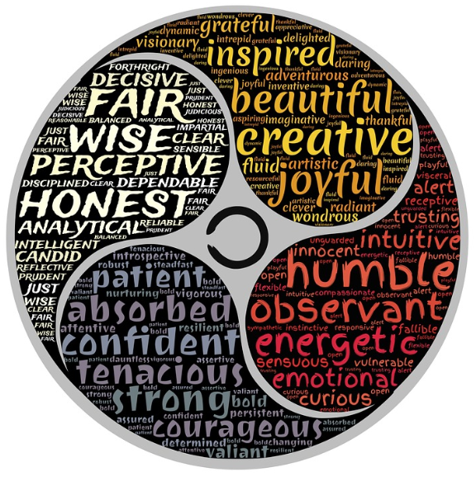
Circle Time
Get in a circle either by standing or rearranging the desks.
Think of three virtues or traits that you like about yourself. Rather than listing interests and talents, think about the different elements of your personality e.g. kind, creative or determined. Think of traits that are perhaps less common or are somewhat unique to yourself.
Think of a virtue or trait about the classmate sitting on your left or right (or a classmate whose name you’ve picked out of a hat).
Go around the circle once, with each student saying, “My three favourite positive traits are _________, _________ and ________” and “One of [classmate name]’s positive traits is ___________.”

Slide 7
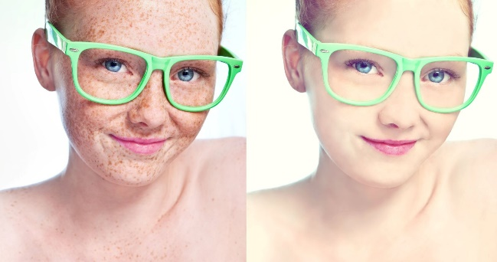
What is beauty?
What does it mean to be beautiful?
How does social media portray beauty online?
What are the different ways people try to represent themselves on social media?
Is beauty more than skin deep?
How can developing your character enable you to become a beautiful person?

