Slide 1
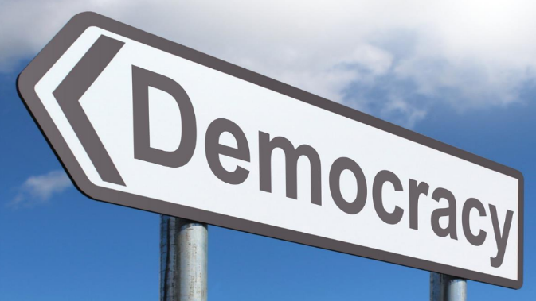
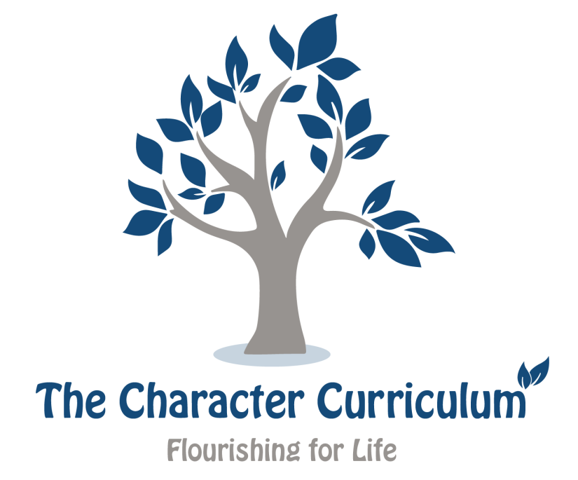
What is democracy?

Slide 2
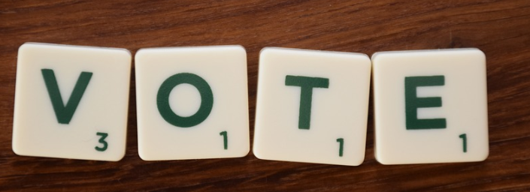
“Elections belong to the people. It's their decision. If they decide to turn their back on the fire and burn their behinds, then they will just have to sit on their blisters.”
―Abraham Lincoln
“The first duty of a man is to think for himself.”
- Jose Marti
How do these quotations relate to the realities of living in a democratic society?
Do you agree with their sentiment? Why?

Slide 3
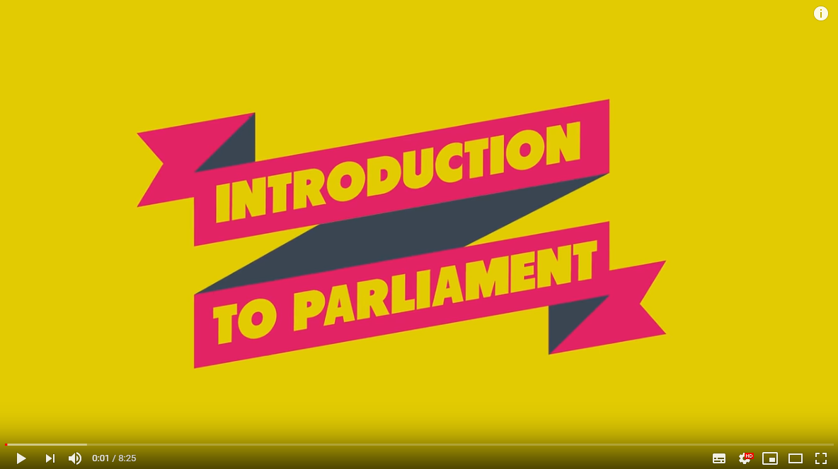
Introduction to democracy, government and parliament.
Have a go at the democracy quiz exploring the role of democracy, government and parliament.
This introduction video about parliament and democracy in the UK gives a brief overview of how the system works.

Slide 4
Types of rule
Look at the different types of leadership described in the table below.
Which of the types of rule do you think is the best? Why?
Are there any positives of the other styles?
Can you think of any examples where you have seen these types of rule in the world?
As somebody developing their character which of the styles of rule would allow you to flourish the most easily?
Anarchy | ...a situation where there is no government at all
Totalitarian state | …a country where there is only one political party or one group of leaders, who have total power
Democracy | … a system of government where representative leaders are chosen by election
Dictatorship | …a system of government where one person or a small group rules, without having been chosen by the people

Slide 5
What virtues does an MP need?
Look at the list of virtues and identify suitable virtues for an MP.
What does an MP do?
What skills and virtues do you think you need to be a good MP?
Which virtues do you think it is most important for MP’s to possess?
Are there any qualities that are missing?
What are the most/least important qualities for MPs? Why?
Could any of these virtues make it difficult to do the job well?

Slide 6
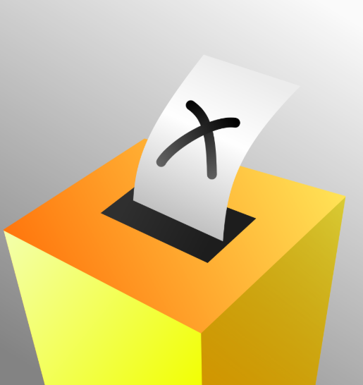
How important do you think it is to vote? Why?
What makes a good voter? Which virtues do you think they need?
Research shows that the younger people are when they first vote, the more likely they are to keep on doing it.
Do you think the voting age should be lowered to 16? Why?

