Slide 1
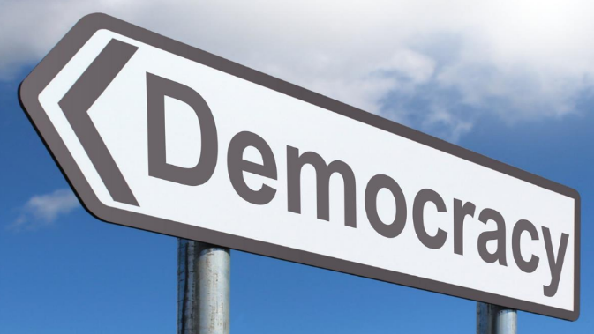
Voting

Slide 2
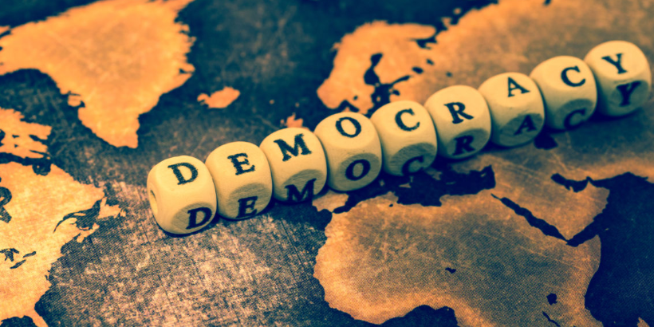
Last lesson focused on what democracy is. Discuss with your partner what you believe democracy to be.
What are the benefits of living in a democracy?
What are the challenges and tensions of living in a democracy?

Slide 3
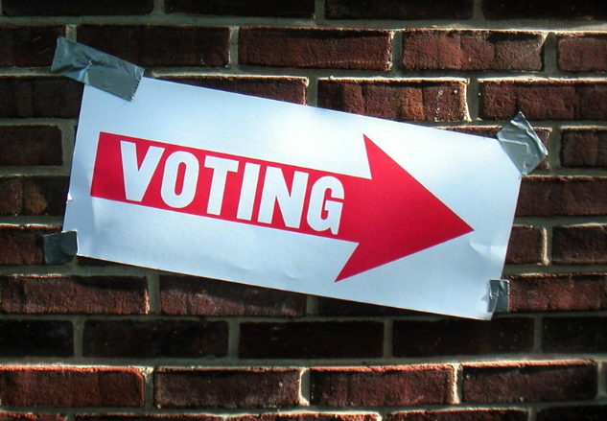
Discuss how voting is a right and a responsibility of living in a democracy.
Many people in many different countries have struggled and died for the right to vote. In recent years in North Africa many young people have protested and overthrown dictatorships for the right to vote.
Why is voting so important that people will risk their career and life to have the opportunity to vote?
What difference does it make who gets elected?
How is voting a benefit?
Why is it a responsibility?

Slide 4
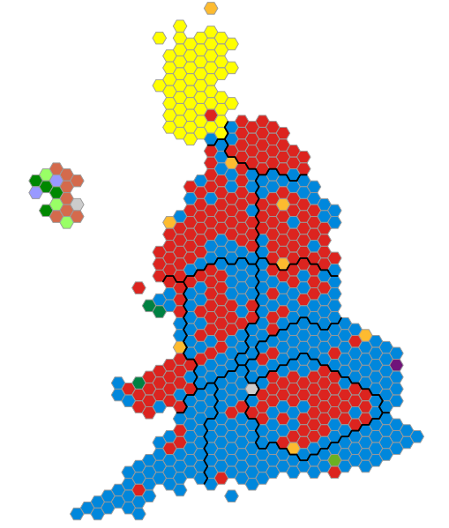
One way that citizens give their opinion about issues is by voting for people who represent their views.
Voting is an important responsibility, because our rights are determined through voting – mainly though electing our MPs and sometimes directly in national referendums (e.g. leaving the European Union).
What would happen if only half of the population was able to vote?

Slide 5
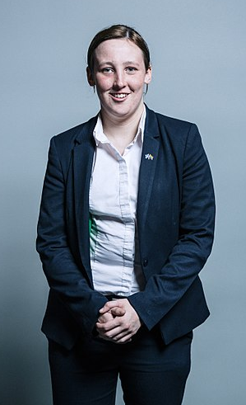
Mhairi Black is a Scottish politician. She has been the SNP Member of Parliament for Paisley and Renfrewshire South since 2015, when she defeated Labour minister Douglas Alexander. She was re-elected at the 2017 general election.
Black is the youngest member in the House of Commons and UK and she became an MP while still a final year undergraduate student at the University of Glasgow. She famously used the library in the houses of parliament to finish her third year University project whilst serving as a new member of parliament
Black is a longstanding critic of Westminster arguing that not enough gets done in government and labelling parliament as being "excluded from reality.” She has been outspoken on issues of poverty and jobs for people in her constituency.
What virtues have she shown in her role?
What barriers do you think she might have faced in parliament?
What virtues would she have needed to have overcome them?

Slide 6
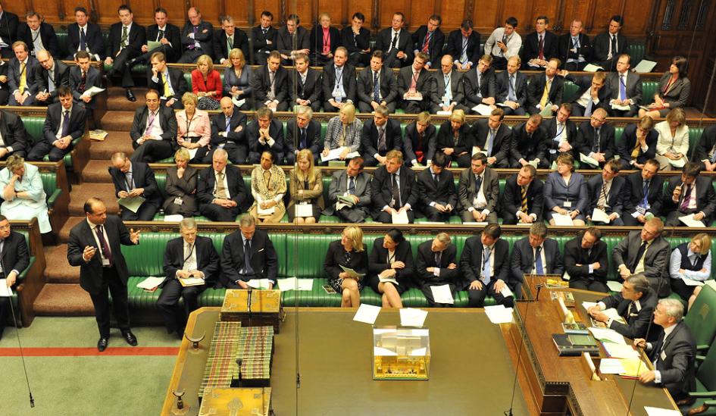
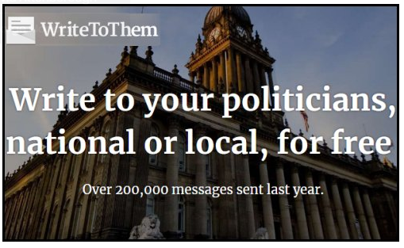
You can look up your local MP to find out what issues they are campaigning for in your area.
You can also communicate with your local MP www.writetothem.com on any issue that you would like to raise.
When someone is considering their vote they need to think about a number of factors as they decide who to vote for.
What might a candidate say to gain your vote?
What might they say that would cause you to vote against them?
What would you say if you were trying to get elected?

Slide 7
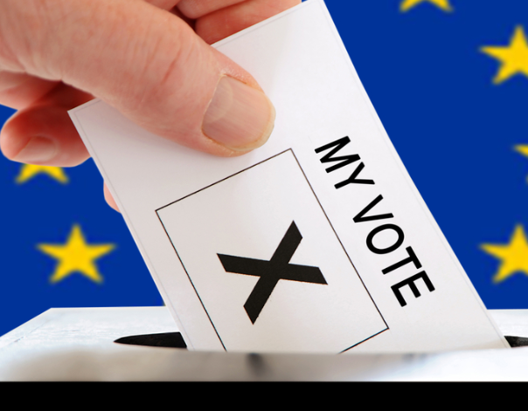
Democracy only works if ordinary people participate.
What are the different ways that people can participate in democracy?
In what ways are you able to get involved in democracy and politics?
Which of the issues in your local community are important to you? What about on a national scale?
Which of the issues in politics today do you find interesting?
Do you feel strongly about any of the major policies/issues being discussed at the moment?

Slide 8
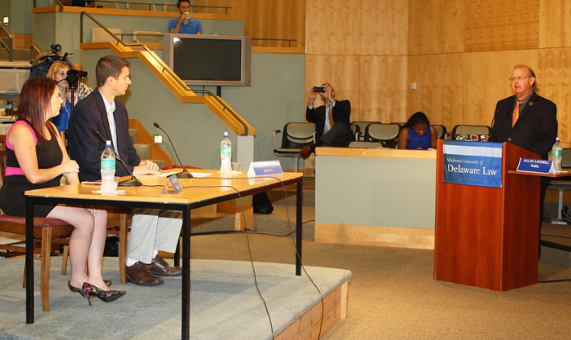
Discuss how students feel about the process of determining what is right when there are two sides to an issue.
Is it possible to disagree well?
What virtues do you need to display to take part in a robust debate?
Can you think of any examples of when you disagreed strongly with a rule or issue in your community/school/home life?

Slide 9
Mike has just been elected as head boy at your secondary school. It is an important position of influence among students and he represents the student views to the school leadership team. The week before term started Mike got himself into an altercation with another group of students from a different school and the police were called. Mike was found to be over the alcohol limit. This was Mike’s first offense. On the first day of term a meeting is called to discuss whether Mike should continue as president. You are part of the committee and are asked your opinion.
What is the problem?
How do you feel about the situation?
Are there any virtues in conflict in this dilemma?
What do you think a wise solution is?
Is there more than one?

