Slide 1
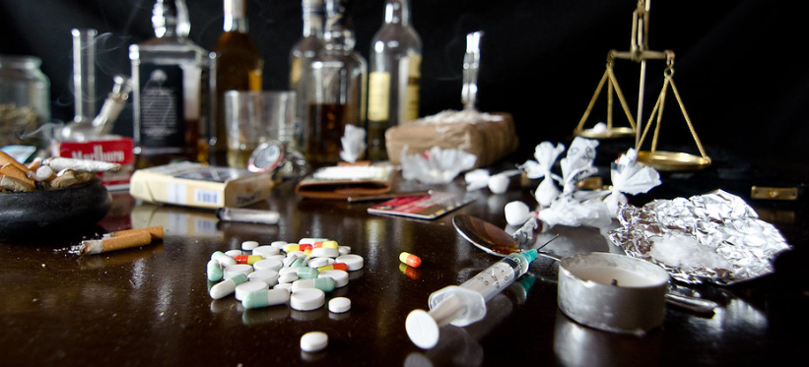
Habits

Slide 2
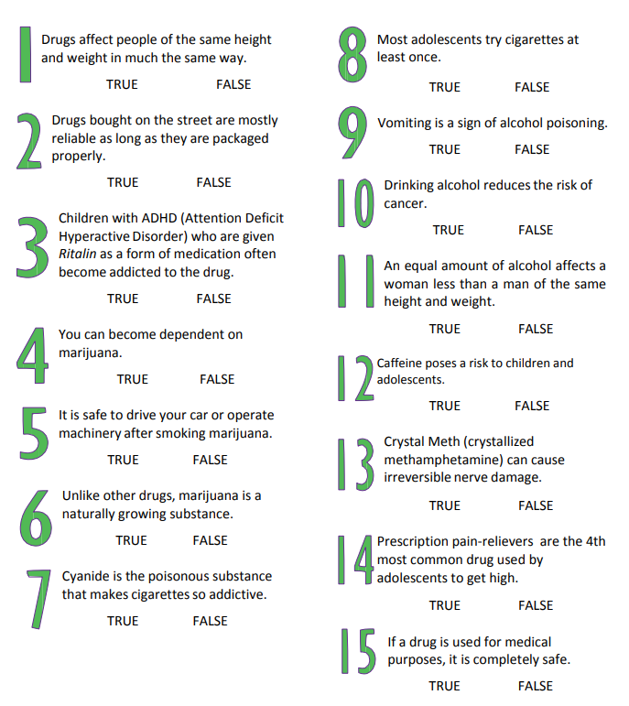
Drugs and Alcohol Quiz
Have a go at the quiz questions and familiarize yourself with some of the statistics about drinking and drugs here.

Slide 3
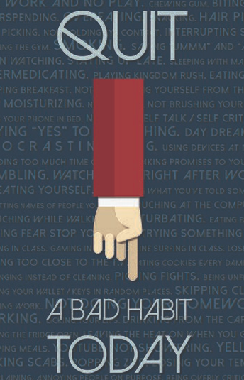
Habits
Most people who smoke, drink too much alcohol or take illegal drugs know about the negative side effects of these substances but still continue take them. Why might that be?
Can you think of any habits or behaviors that you find difficult to control? Share with a partner.
Why is breaking a habit so difficult?
Can you think of a time you tried to break a habit and found it difficult? Why was it so hard?
What virtues do you need to be able to recognize that something is a problem and try and get it under control?
What virtues could you develop to help you make wise choices?

Slide 4
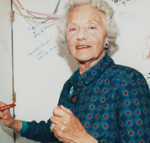
Role Model
Read the story of Mollie Craven and how she founded Addaction.
What virtues did Molly have to display in her story? What did she have to overcome?
What challenges would Molly have had to face in raising awareness of drug addiction and the support of families effected?
You can read the Mollie’s original letter here.
Fifty years ago, the Guardian newspaper published a letter from Mollie Craven. Mollie’s son had been a registered heroin addict since the age of 18 and, she felt powerless to help. Her vision was for a parental support group that could research the little understood issue and support each other to find effective ways of helping children with drug problems. That organisation was founded in 1967 as APA, standing both for the Association of Parents of Addicts, and the Association for Prevention of Addiction. Sadly, Mollie's son died at the age of 21, but she continued her pioneering work into the 1990s, helping to influence policy in the UK. APA also continued, moving increasingly into harm reduction and treatment services throughout the heroin epidemics of the 1980s and 90s, and rebranding as Addaction in 1998. Addaction has grown significantly since then, from 19 services in 1998 to 120 today and now employs nurses, doctors and pharmacists helping to expand the charity’s reach and influence.

Slide 5
Jo was a pretty assertive young woman. She had gone to a party her parents agreed she could attend. In arranging a lift, her mother had called the parents of a family friend of Jo’s she knew to share lifts. Jo’s mum would drive them there and Chris’s Dad would pick them up. At the end of the night when Chris’ dad arrived to pick them up, the smell of alcohol overwhelmed Jo. She got in and thanked Chris’s Dad for coming to get them. He seemed normal to Jo, but she wasn’t sure what a drunk driver looked like. Jo’s parents had told her if she ever felt uncomfortable to call home and they would pick her up, no questions asked. But, what if the driver was a friend of her parents and an adult? What could she do?
Moral Dilemma
Students read the moral dilemma.
What is the problem?
What virtues are involved?
What is a ‘wise’ solution? Is there more than one?
What would you do in this situation?
Have you experienced a situation like this?

Slide 6
Thinking forward
Think about the kind of person you want to become in the future. You could think about the practicalities of the type of career you want and/or the type of person you want to become.
What virtues would you like to display etc.?
How might getting caught up in drug and alcohol abuse make this difficult?
How might it impinge on you becoming the best version of yourself?

