Slide 1
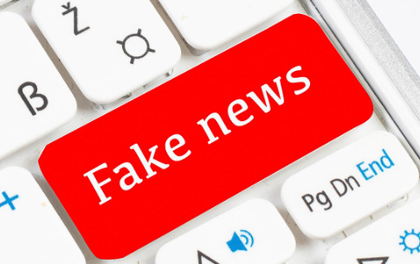
What makes a virtuous consumer of news?

Slide 2
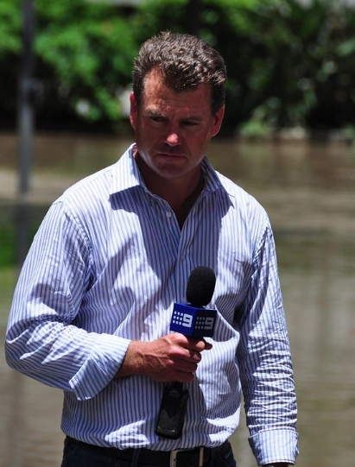
What virtues might make somebody good at reporting the news?
What is the primary job and responsibility of someone who reports the news?

Slide 3
Avoiding fake news
We explored the rise and consequences of fake news in the last lesson.
How might you go about avoiding fake news?
How might you ensure the quality and reliability of the information you take in?

Slide 4
Consider the source
Read beyond the headline
Check the author
What’s the support?
Check the date
Check your biases
Consult the experts

Slide 5
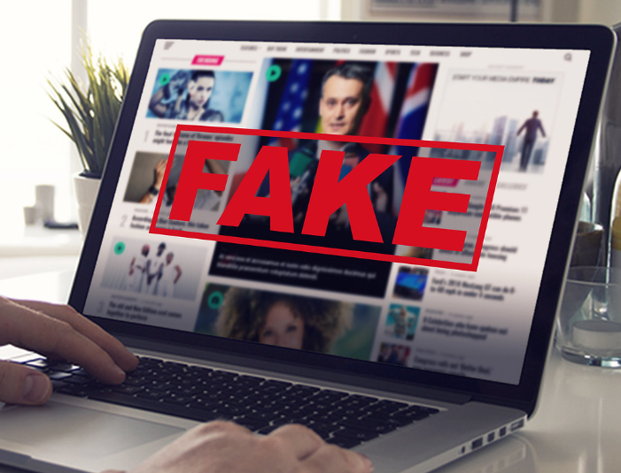
Why is fake news making news?
Read through the resources sheet with some recent examples of fake news making the news.
Why are these examples of fake news so significant?
In what ways do these examples display a lack of virtue from those involved?
Which negative character traits are they potentially displaying?

Slide 6
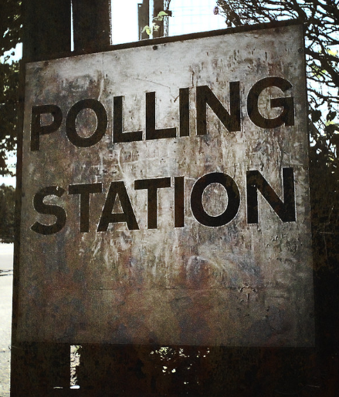
Thinking questions
Read through the ‘How can fake news affect our democracy?’ document and discuss the issues with your partner.
Should people be able to make important decisions if the information they have is unreliable?
Is the majority always right?
How are the media important in a democracy?
Should a leader always listen to their people?
Discuss these issues in groups/pairs and then feedback to the group.

Slide 7
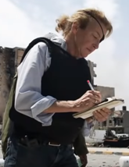
Role model - Marie Colvin
Many journalists are given the title of war correspondent. Few people have really deserved it as much as Marie Colvin. Colvin was an American reporter who wrote for the British newspaper The Sunday Times. She was unmistakable in war zones — she sported an eye patch to cover up an eye injured in a grenade attack while she was reporting during the Sri Lankan civil war. Colvin wrote vivid reports from places few Western correspondents would go — Chechnya, East Timor and, ultimately, Syria. She was killed on Feb. 22, 2012, after the Syrian government shelled the media centre they were staying in. She was committed to being an eyewitness to war, and to telling the story of people who go through it. She was dedicated to telling the truth and relaying the events of many horrendous conflicts around the world.
What virtues did Marie display in her story? What did she have to overcome?
What challenges would Marie have had to face in bringing attention to the horrors of war?

Slide 8
Curiosity
Why is it important to be curious?
Can you give an example?
In Activity 2 you outlined some of the negative character traits that might be associated with pedalling fake news.
Can you describe the opposite and positive character traits that needs to be developed in its place?

