Slide 1



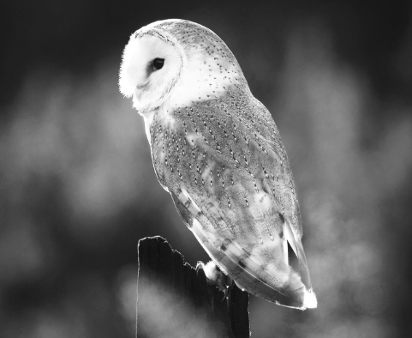


Conceptualising and Measuring
Practical Wisdom
Kristján Kristjánsson
www.jubileecentre.ac.uk

Slide 2


Agenda
What phronesis is
Five theoretical models of phronesis
The development of the first (long) phronesis measure
The development of the second (short) phronesis measure
A network model of phronesis
Phronesis and flourishing
Added value over Moral Foundations

Slide 3

What is Aristotelian Phronesis?
Intellectual meta-virtue which guides the moral virtues
Feeding on character traits cultivated in the young through habituation, phronesis – after it comes into play (when???) – re-evaluates those traits critically
Core function to adjudicate the relative weight of different virtues in conflict situations and to reach a measured verdict about what to feel and do in light of eudaimonia: the ultimate good and unconditional end of human beings
EXCELLENCE IN ETHICAL DECISION MAKING

Slide 4

Domains of Virtue
Moral
Intellectual
Civic
Performance

Slide 5
Five Theoretical Models
The Standard Aristotelian Model
see above (Russell, Snow, Kristjánsson & Fowers)
The Aretai Model
General expertise in ethical decision-making, logically prior to individual virtues (De Caro & Vaccarezza - & Navarini et al.)
The Eliminativist Model
No special construct, is divided between different psychological processes (Miller, Lapsley)
The MacIntyrean model
General decision-making skills within ‘practices’ (MacIntyre)
The Postmodernist Model
Non-rational intuitive artistry (Kemmis, W. Carr)

Slide 6
The phronesis bandwagon…
Last 30 years:
Phronesis not only studied with more rigour in philosophy than ever before, it has also become something of a buzzword within pockets of social science
Also acquired a status within formidable recent approaches of the virtue ethical kind to professional ethics, especially in the so-called ‘people professions’
But until Grossmann et al. (2020), wisdom as ‘morally grounded perspectival metacognition’, mostly studied independent of wisdom in psychology
PRE-2019 NO CLEAR CONCEPTUALISATION AND NO MEASURE!!
Kristjánsson, K., Fowers, B., Darnell, C., Pollard D. (2021). Phronesis (practical wisdom) as a type of contextual integrative thinking. Review of General Psychology, 25(3).
Darnell, C., Fowers, B., & Kristjánsson, K. (2022). A multifunction approach to assessing Aristotelian phronesis (practical wisdom). Personality and Individual Differences, October issue.

Slide 7
Defining Phronesis
Phronesis
(4 components)
Virtue Literacy
Moral action
1) Moral perception/sensitivity
Ability to identify the moral problem and the perception of virtue
3) Moral identity/Blueprint
Knowledge/ appreciation of the good life.
4) Moral adjudication/
integration
Ability to identify conflicting virtues and to reason about the ‘right’ decision.
2) Moral emotion/Emotional regulation
Emotional understanding (e.g., empathy or sympathy).

Slide 8
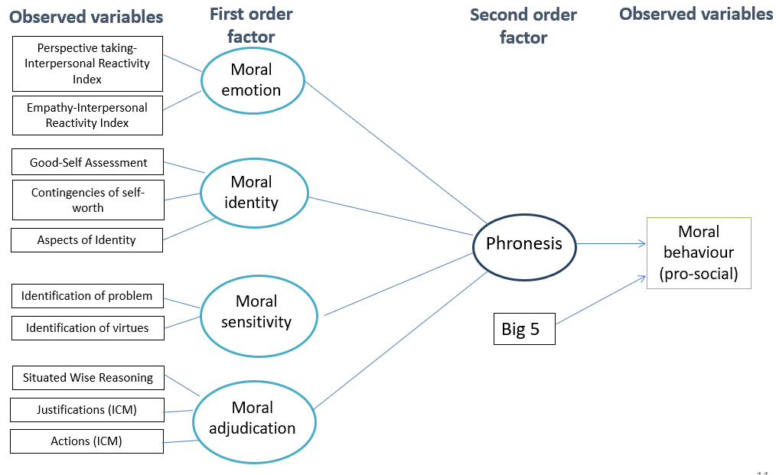
Darnell et al., 2022

Slide 9
Problem with the Long Measure
Only CFA, not EFA – and hierarchical structure assumed
Too small samples and only from the UK
Unwieldy measure and much too long for pre-and-post testing (45 min.)
Outcome variable self-reported pro-social behaviour only: very un-Aristotelian!
No exploration of association with flourishing
No sub-cohorts of different professionals

Slide 10
The development of the second (short) phronesis measure (15 min.)
McLoughlin, Thoma, and Kristjánsson (forthcoming)

Slide 11
Participants
Sample | Purpose
2000 UK participants | Testing how many Phronesis components there are
1000 UK participants | Replicating/confirming Phronesis structure Testing how Phronesis relates to core psychological characteristics (e.g., moral foundations, moral relativism)
1000 US participants | Testing whether findings hold up in the US sample Testing how Phronesis relates to applied concerns (e.g., emerging technology, consumer behaviour)
300 Medical Practitioners US | Comparison with other professions
300 Entrepreneurs US | Comparison with other professions
300 Teachers US | Comparison with other professions

Slide 12
How many dimensions of Phronesis?
Moral Perception
Situational Moral Irrelevance
“Do people successfully recognise when situations are not morally relevant?”
Situational Moral Relevance
“Do people successfully recognise when situations are morally relevant?”
Virtue Identification
“In morally relevant situations, do people recognise which virtues are at stake?”
Moral Emotion
Positive Moral Emotion
“Do people feel good when they do good things?”
Negative Moral Emotion
“Do people feel bad when they do bad things?”
Emotional Regulation
“Can people contain their emotions in distressing situations?”
Moral Identity
Moral Self Relevance
“Do people believe being moral is personally relevant?”
Aspired Moral Identity
“Do people have a clear picture of their best moral selves?”
Moral Adjudication
Moral Deliberation
“Do people ask themselves whether they have all the right information before making a decision?”
Moral Integration
“Do people make decisions considering which virtues are at stake, how they would feel about themselves, and how consistent an action is with their aspired moral identity?”

Slide 13
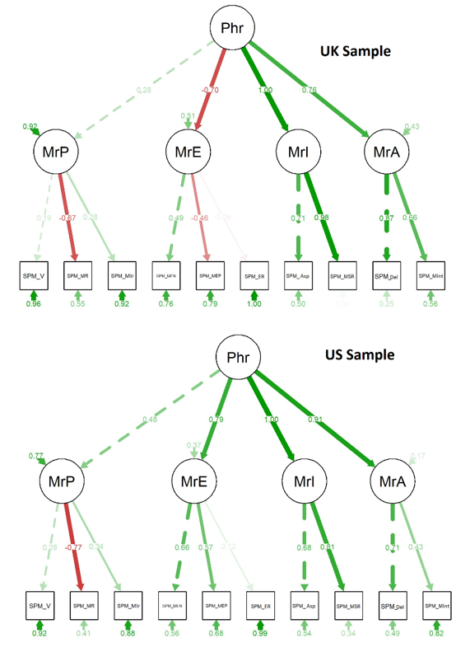
Model fit in US vs UK

Slide 14
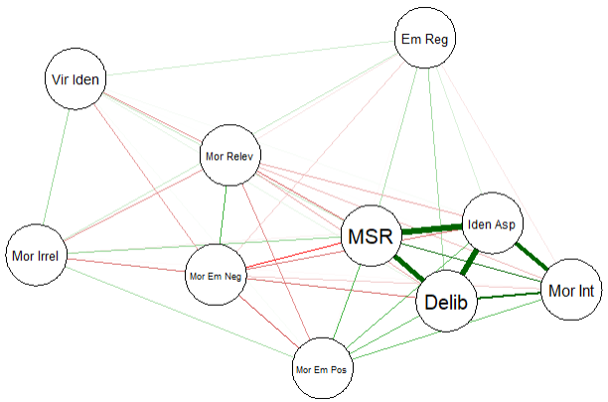
Network Model of Phronesis
Assesses the centrality of each component
Central components can be targeted in character education
Does not assume a hierarchical structure
Identity and Adjudication components more central than Perception and Emotion

Slide 15
Aristotle was right about Flourishing and Phronesis (N: 4000 UK/US) !
 | Emotional Health | Physical Health | Meaning and Purpose | Financial Security | Social Connectedness | Character Strengths
Moral Perception | .01 | -.015 | .059 | .016 | -.011 | -.008
Virtue Identification | .01 | -.004 | .044 | .031 | -.001 | .015
Situational Moral Relevance | .026 | -.032 | .012 | .033 | -.005 | .004
Situational Moral Irrelevance | -.026 | .018 | .03 | -.033 | -.01 | -.029
Moral Emotion | .237*** | .207*** | .302*** | .027 | .265*** | .426***
Negative Moral Emotional | -.132*** | -.14*** | -.267*** | -.073* | -.209*** | -.316***
Positive Moral Emotion | .122*** | .126*** | .179*** | -.026 | .17*** | .295***
Emotional Regulation | .185*** | .137*** | .139*** | .01 | .135*** | .216***
Moral Identity | .192*** | .173*** | .336*** | .077* | .243*** | .429***
Identity Aspiration | .223*** | .173*** | .326*** | .103** | .269*** | .425***
Moral Self-Relevance | .115*** | .117*** | .256*** | .032 | .157*** | .321***
Moral Adjudication | .188*** | .191*** | .285*** | .072* | .207*** | .355***
Moral Deliberation | .208*** | .213*** | .308*** | .104** | .208*** | .434***
Moral Integration | .109*** | .098** | .156*** | .015 | .14*** | .174***

Slide 16

Predicting outcomes of interest over and above Moral Foundations
Outcome Predicted | Total % Moral Foundations | Additional % Phronesis | Additional % Phronesis Network
Machiavellianism | 6.83 | +0.13 | +9.27
Narcissism | 5.86 | +0.00 | +12.70
Psychopathy | 6.58 | +2.40 | +20.10
Sadism | 12.50 | +1.50 | +23.00
Honesty/Humility | 14.20 | +0.92 | +10.00
Emotional Health | 6.02 | +2.55 | +7.38
Physical Health | 5.11 | +1.91 | +5.30
Financial Security | 9.98 | +0.21 | +1.16

Slide 17
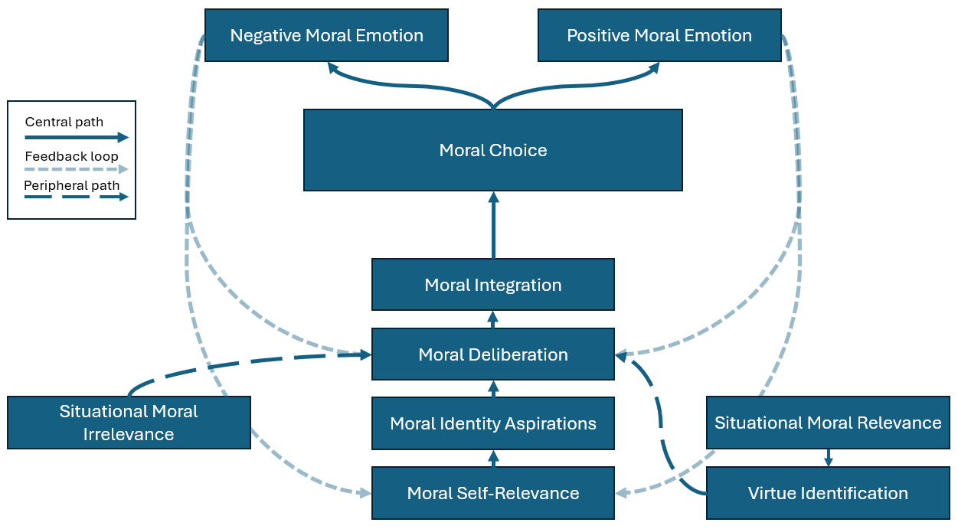
A New Phronesis Model

Slide 18


Thank You!
k.kristjansson@bham.ac.uk

